Slide 1
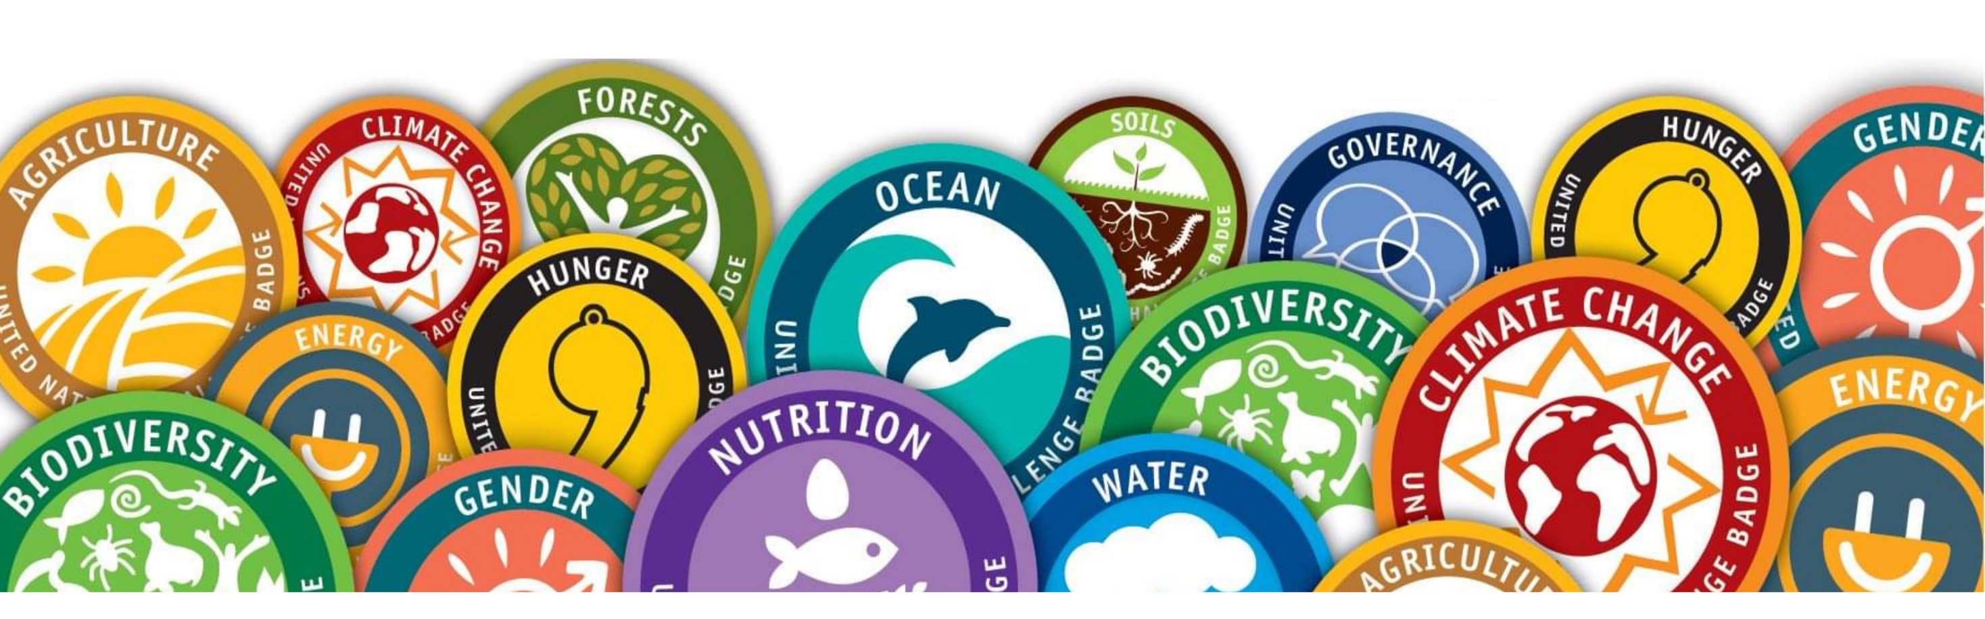
YUNGA Montserrat

Slide 2

What is YUNGA ?
The United Nations created the Youth United Nations Global Alliance as a way to encourage young persons to use their “enthusiasm, imagination and energy” to overcome from the world’s greatest challenges.
Formed in 2009, YUNGA is a partnership between UN agencies, civil society organizations, and other entities.
YUNGA acts as a gateway for children and youth to participate in UN activities.

Slide 3
Vision
Convinced: Instilling environmental and social awareness at a young age.
Unanimous: Belief in children's and young people's capability to change society.
Regretful: Acknowledgement of the injustices faced by young people.
Resolute: Active participation of young people in decision-making processes.
Conscious: Empowerment of children and young people.
Aware: Similar objectives with many national and international youth organizations.
Determined: Collaborative efforts to support initiatives addressing environmental, social, and educational concerns

Slide 4
Why are children and youth important?
43% of the world's population under 25 years old.
Youth concerned as thoughtful citizens capable of societal change.
Unique perspectives and dynamic contributions.
https://www.fao.org/yunga/home/en/

Slide 5
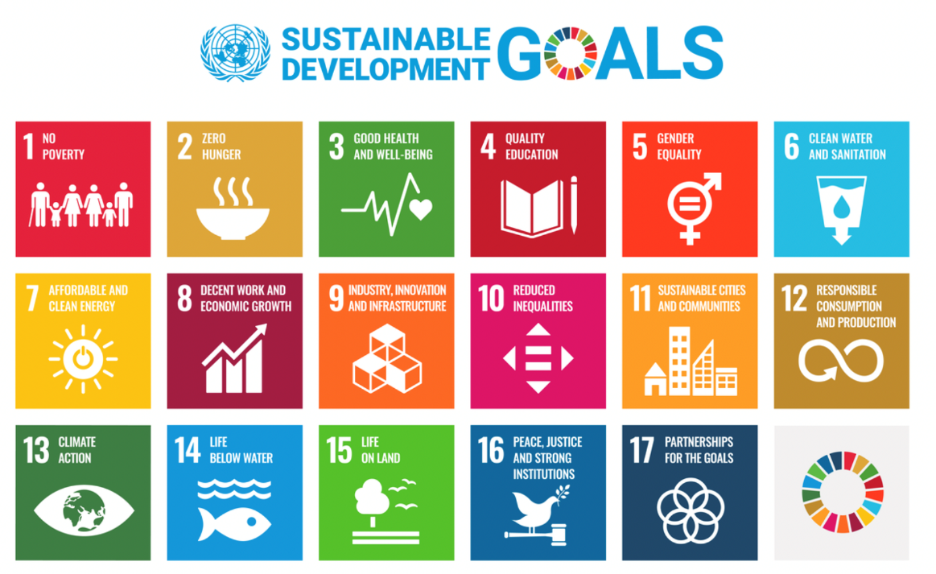
YUNGA seeks to empower children and young people to have a greater role in society, raise awareness and become active agents of change.
.
They have a series of badges based on the Sustainable Development Goals.
Young people complete each Challenge Badge and in doing so think about how they can change their behaviour for the better.
In Montserrat we are launching the first Challenge Badge: the Biodiversity badge.
https://www.fao.org/yunga/home/en/

Slide 6

Biodiversity badge
This cloth badge is gained through learning about and taking action for Montserrat’s environment
Some young people are already doing things to help the environment for example beach cleans, attending and helping with Monty’s Messengers
This badge will allow you to get recognition for your work.
The badge is for school age young people attending secondary school.

Slide 7
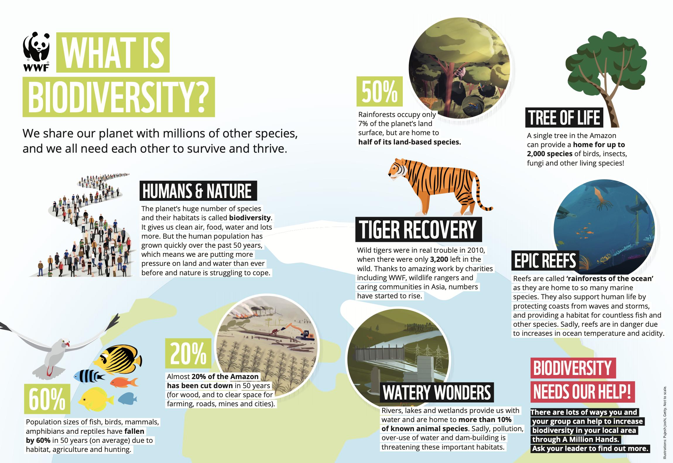

Slide 8
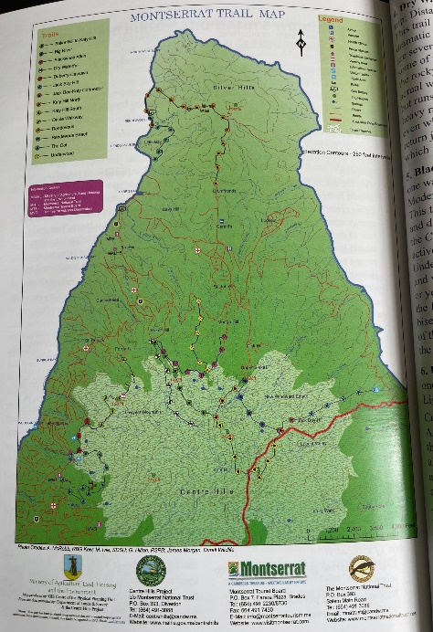
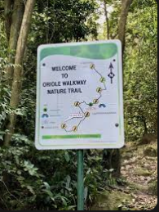
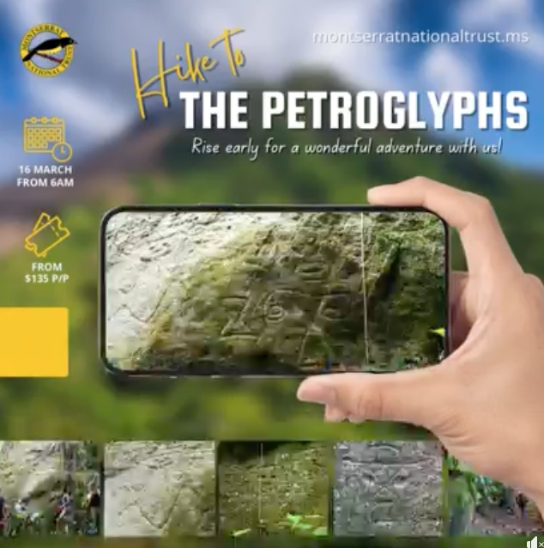
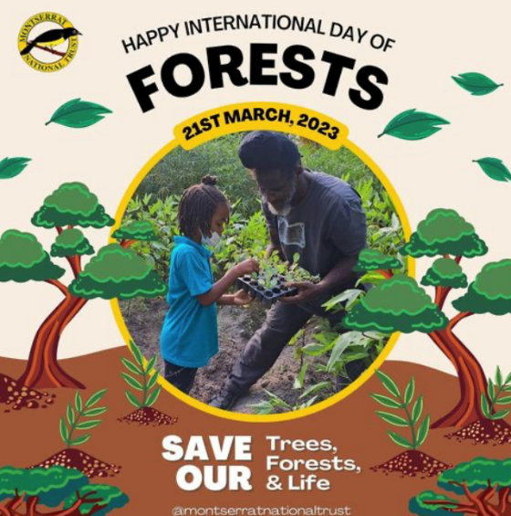
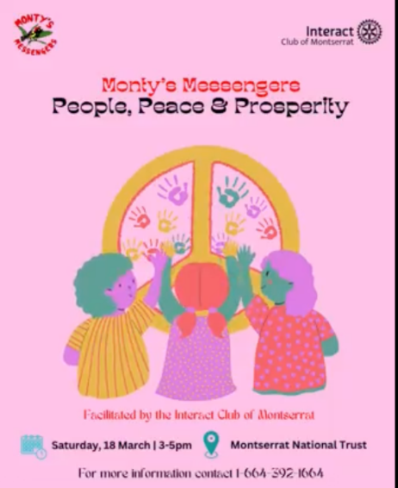

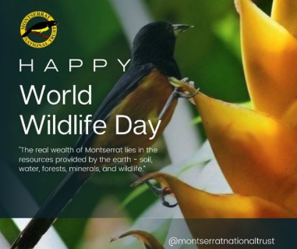

What do I need to do?
Complete 8 environmental activities: 2 from each category of Land; Air; Water; World (Environment)
If you have an idea for an activity, ask Montserrat National Trust who will give it a category and then it will count.
Individual/family activity
Find organised events on MNT’s Facebook page: https://www.facebook.com/MontserratNationalTrust
School activity
Organised Activity
Celebrate an international day by doing an activity associated with it

Slide 9


How do I submit my work?
This may vary. The school may set up a school wide team and have a YUNGA coordinator- if you do that then your YUNGA coordinator only needs contact the Montserrat National Trust. Otherwise, YUNGA Montserrat will coordinate a google page for a young person
Upload pictures of you doing the event or activity and write a short sentence about what you did.
After 8 events you write your concluding thoughts about what you have learnt and what you will change about your behaviour to be kinder to the planet
How do I get my badge ?
Badges and certificates will be sent to schools and the school will present them to you.

Slide 10



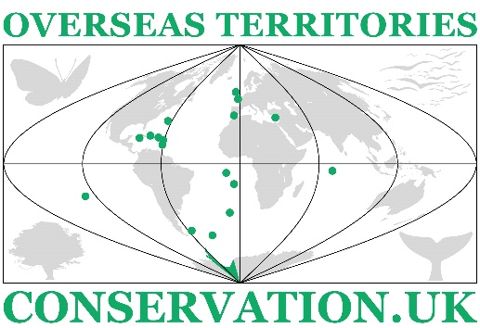

Partners & SUPPORTERS
Any other questions?
Thank you for listening
https://www.ukotcf.org.uk/yunga-montserrat/

